Slide 1
Infection Prevention and Control in Healthcare Facilities
State Institute of Health & Family Welfare
Rajasthan

Slide 2
Objectives of the IPC programme
The objective is to minimize the risk of HAIs to patients, HCWs and visitors.
This is achieved by
Enabling and assisting all categories of HCWs to adhere to comprehensive IPC practices at all levels of care; and
Providing safe and quality healthcare and improving outcomes by reducing morbidity and mortality.

Slide 3
Structure of IPC programme
Hospital infection control committee
Chairperson: Head of the institute
Member-secretary/ infection control officer
Member - Representation from management/ administration: Dean/ Director of hospital; nursing services; medical services; operations R Representation from relevant medical and surgical disciplines R Representation from support services: operation theatre (OT), central sterile supply department (CSSD), housekeeping/ sanitation, laundry, engineering, pharmacology/ pharmacy, stores/ materials department R Infection control nurse (ICN)

Slide 4
Responsibilities
Establish the IPC programme in the HCF
Constitute an infection control team.
Review and revise annually infection control guidelines with policies, recommendations and working protocols.
Organize training programme
Conduct and analyize surveillance of AMR and HAI
Evaluate the effectiveness of interventions for IPC
Prepare an annual IPC plan with a detailed budget.

Slide 5
Common sources of infection in HCF
Environment : Blood, body fluids, secretions, excretions, placenta, contaminated sharps and other equipments.
Other clients and attendants
Health care delivery personnel
People in the community

Slide 6
Principles of Infection Prevention
All objects in contact with the client: Potentially contaminated
Every person: Potentially infectious
If an object is disposable: Discard as waste.
If reusable: Prevent infection by decontamination cleaning, disinfecting or sterilizing

Slide 7
Standard Precautions
Hand hygiene
Personal protective equipment
Respiratory hygiene and cough etiquette
Prevention of injuries from sharps
Safe handling of patient-care equipment
Principles of asepsis
Environmental infection control
Patient placement
Environmental cleaning
Linen and laundry
Waste disposal

Slide 8
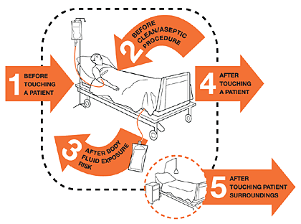
5 Moments of Hand washing

Slide 9
Steps of Hand Washing

Slide 10
PPE
includes
Gloves,
Medical masks,
Goggles or a face shield,
Gowns,
as well as for specific procedures, respirators (i.e., N95) and aprons.

Slide 11
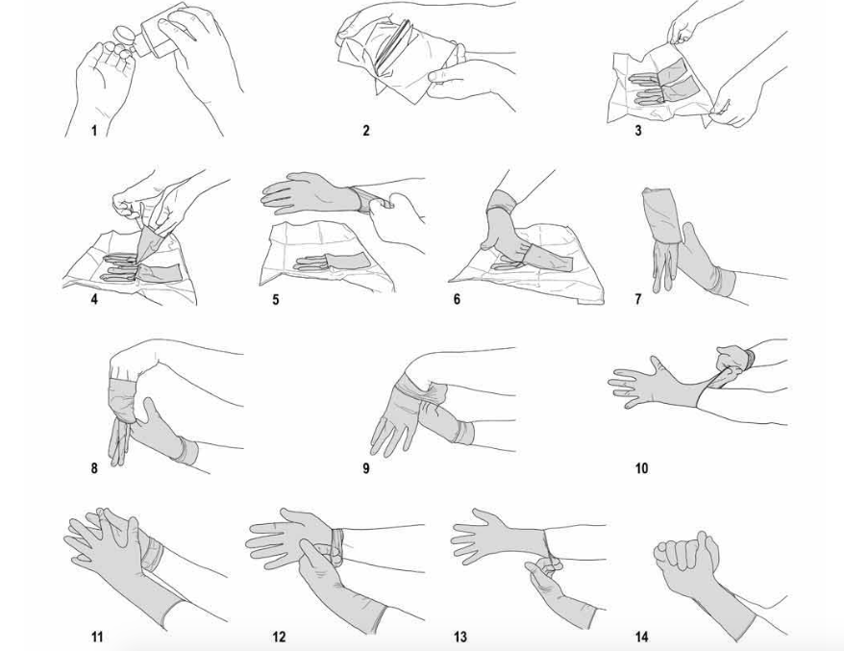
How to wear gloves

Slide 12
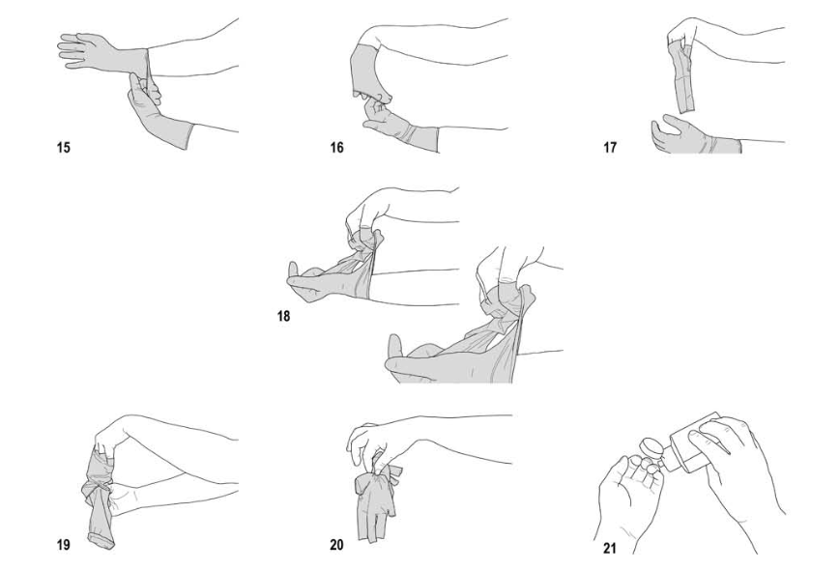
How to remove gloves

Slide 13
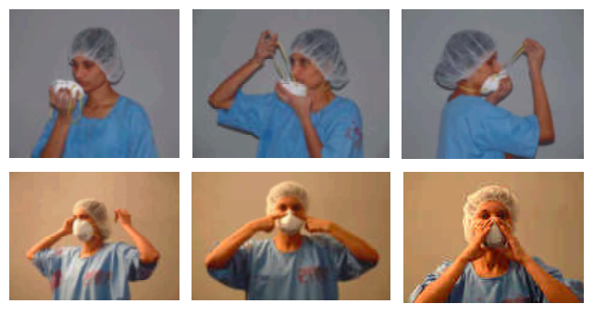
Steps in Wearing Mask
^{Wash hands and dry.}
Remove the clean mask from the container with clean hands.
Ensure the mask is fitted properly.
If glasses are worn, fit the upper edge of the mask under the glasses..A secure fit will prevent both the escape and the inhalation of micro-organisms around the edges of the mask and fogging of the eyeglasses.
^{Precautions}
Avoid talking, sneezing, or coughing if possible.
Masks cannot be worn with beards/unshaven faces.
The mask should completely seal the face at all times to ensure effective filtering of micro-organisms

Slide 14
Respiratory hygiene and cough etiquette
Cover mouth and nose with a tissue when coughing or sneezing.
Dispose the tissue after use in the nearest waste container.
Perform hand hygiene after contact with respiratory secretions and contaminated objects or materials.

Slide 15
If resources permit, HCFs should ensure the availability of materials such as tissues and foot-operated waste bins for adhering to respiratory hygiene and cough etiquette in waiting areas for patients and visitors.
In the absence of handkerchief or tissues, patients should be instructed to cover their nose and mouth with their arm during coughing and sneezing.
Provide conveniently located dispensers of ABHR.

Slide 16
Respiratory hygiene and cough etiquette
Where sinks are available, ensure that water and soap for hand washing are available at all times.
Posters elaborating cough etiquette and hand hygiene must be displayed.
Posters in the local language should be put up at appropriate locations in HCF with instructions for patients / attendants to inform the healthcare staff if they have symptoms of respiratory infection
And on how to practice respiratory hygiene and cough etiquette.

Slide 17
Standard Precautions: Proper Handling and Disposal of sharps
Needles and syringes
Use disposable needle and syringe ONLY ONCE.
Always wear utility gloves while handling sharps
Do not disassemble the needle and syringe after use.
Do not recap, bend or break needles before disposal.
Make needles unusable after single use by burning them in a needle destroyer
Never burn syringes

Slide 18
Safe handling of patient-care equipment
Equipment that has been soiled with blood or body fluids should be decontaminated and cleaned to prevent transfer of microorganisms to other patients and the environment.
Cleaning of patient-care areas and equipment should be carried out by a team of dedicated personnel trained in the appropriate cleaning procedures. Responsibility and accountability for cleaning should be assigned.

Slide 19
Safe handling of patient-care equipment
A hospital disinfection policy should be prepared for appropriate cleaning, disinfection and sterilization of patient-care devices that come in contact with mucous membranes and access sterile tissues.
The policy should be strictly followed and monitored. Accountability and responsibility should be assigned.

Slide 20
Safe handling of patient-care equipment
A new equipment or serviced and repaired equipment should be cleaned and disinfected before patient use as per hospital policy.
Heavy duty or strong utility gloves must be worn during decontamination, cleaning and disinfection of instruments.
Soiled patient-care equipment should be handled in a manner that prevents exposure of skin and mucous membranes and contamination of clothing and environment.

Slide 21
Safe handling of patient-care equipment
Disposable patient-care equipment should not be reused and must be discarded into an appropriate container in accordance with the hospital waste management policy and the Biomedical Waste Management and Handling Rules 2016, 2018.
Patient-care supplies (e.g. lotion, cream, soap) shall not be shared by patients

Slide 22
Principles of asepsis
Patient placement in ward
Spacing between beds should be 1–2 metres.
Single rooms
Single rooms reduce the risk of transmission of infection from the source patient to others by reducing direct or indirect contact transmission.
Single rooms should have:
Hand-washing facilities
Toilet and bathroom facilities.
Anterooms Single rooms used for isolation purposes may include an anteroom to support the use of PPE.

Slide 23
Standard Precautions: Processing of Used Items
A. Decontamination
B. Cleaning
C. Sterilization or high level disinfection (HLD)
D. Storage

Slide 24
Decontamination & Cleaning
Preparation of Chlorine Solution
Decontamination of Operating Surfaces
Decontamination of Instruments after use
Cleaning of Instruments
Contact Time for Decontamination

Slide 25
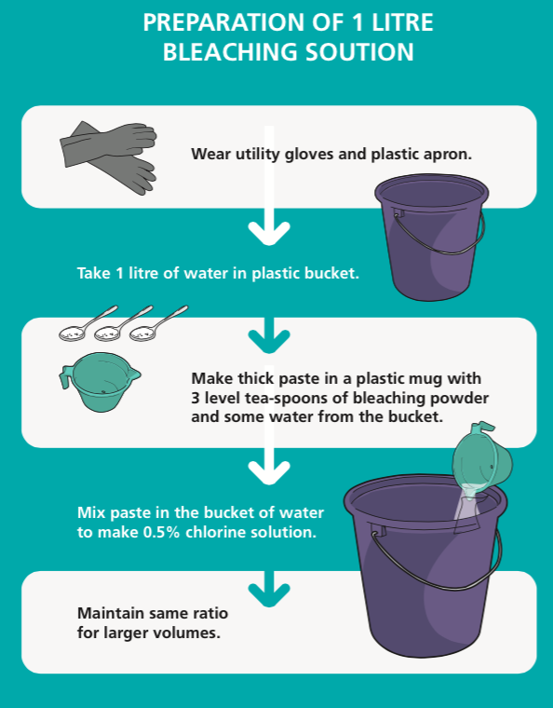

Slide 26
Steps of processing instruments and other items
Decontamination
(Soak in 1% chlorine solution 10 minutes)
Cleaning with brush, detergent and water
Preferred Method
Acceptable Method
Sterilization
HLD
Autoclave
15lbs/In2 pressure 121ºC, (250ºF)
20 min/30 min
Chemical
Soak in Glutaraldehyde (2%) for 8 hrs, Rinse with sterile water
Boiling
Lid on 20 minutes
Chemical
Soak in Glutaraldehyde (2%) for 20 min. Rinse with boiled for 20 min
Cool, dry and Store

Slide 27
Spill Management
Wear appropriate PPE
Place absorbent material on spill
Apply Disinfectant
Dispose the Contaminated Material
Disinfect the spill area again
Clean the equipment
Remove Personal protective equipment
Wash your hands
Report the spill

Slide 28
Standard Precautions: Maintaining Clean Environment
Type of cleaning solution | Uses
Plain detergent and water | To remove dirt & organic material such as grease, oil
Disinfectant 0.5 % chlorine solution | To clean up spills of blood or other body fluids
Disinfectant cleaning solution | For cleaning areas – operation theatres, procedure rooms , latrines

Slide 29
Area/Items | Item/Equipment | Process | Method/Procedure
Clinical Area
General clinical areas | Dust mops ( no broom will be used for Sweeping)- | Sweeping Cleaning Daily mopping | Sweep with the dust mop or Mop Cleaning damp mop to remove surface dust. Sweep under the furniture and remove dust from corners. Gathered dust must be removed using the hearth brush and shovel The seep tool should be cleaned or replaced after used

Slide 30
Area/Items | Item/Equipment | Process | Method/Procedure
Clinical Area
Floors (clinical areas) – daily mopping | Detergent/ sanitizer–hot water, sodium hypochlorite(1%) Three-bucket( one with plain water and one with detergent solution; one bucket for sodium hypochlorite(1%) |  | Prepare cleaning solution using detergent with warm water Use the Three buckets technique for mopping the floor, one bucket with plain (one with plain water and one with the water and one detergent solution First mop the area with the water and detergent solution. • After mopping clean the mop in plain water and squeeze it. Repeat this procedure for the remaining area. • Mop area again using sodium hypochlorite 1% after drying the area. • In between mopping if solution or water is dirty change it frequently. • Mop the floor starting at the far corner of the room and work towards thedoor. • Clean articles between cleaning. Note: Mopping should be done twice a day

Slide 31
Area/Items |  | Item/Equipment |  | Process |  | Method/Procedure
Clinical Area
Ceiling and Walls | Sweeping tool Duster Bowl/ small bucket of soap solution Plain water |  | Damp dusting |  | Damp dusting with a long handled tool for the walls and ceiling done with very little moisture, just enough to collect the dust. • Damp dusting should be done in straight lines that overlap one another. • Change the mop head/cover when soiled. Note: Should be done once a week or after examining a suspect case
 | Care of mop |  | Hot water Detergent Sodium hypochlorite 1% |  | Clean with hot water and detergent solution, disinfect it with sodium hypochlorite and keep for drying up side down.

Slide 32
Area/Items | Item/Equipment |  | Process | Method/Procedure
Clinical Area
Doors and door knobs | Damp cloth or Sponge squeeze mop detergent | Thorough washing |  | The doors are to be washed with s a brush, using detergent and water once a week (on one defined day); gently apply cloth to soiled area, taking care not to remove paint, then wipe with warm water to remove excess cleaning agent. • Door knobs and other frequently touched surfaces should be cleaned daily
Isolation room | Detergent/ Sanitizer– warm water, sodium hypochlorite (1%) Three buckets (one with plain water and one with detergent solution); . separate bucket for sodium hypochlorite (1%) | Terminal cleaning |  | Before cleaning an isolation room, liaise with infection control team for details of any special requirements. Staff will be instructed on specific cleaning procedures required with reference to • Safety uniform to be worn • Chemicals or disinfectants to be used. • Also, if bed screen and shower screen are to be cleaned or changed, refer cleaning in isolation rooms

Slide 33
Area/Items | Item/Equipment | Process | Method/Procedure
Clinical Area
Doors and door knobs | Damp cloth or Sponge squeeze mop detergent | Thorough washing | The doors are to be washed with s a brush, using detergent and water once a week (on one defined day); gently apply cloth to soiled area, taking care not to remove paint, then wipe with warm water to remove excess cleaning agent. • Door knobs and other frequently touched surfaces should be cleaned daily
Isolation room | Detergent/ Sanitizer– warm water, sodium hypochlorite (1%) Three buckets (one with plain water and one with detergent solution); . separate bucket for sodium hypochlorite (1%) | Terminal cleaning | Before cleaning an isolation room, liaise with infection control team for details of any special requirements. Staff will be instructed on specific cleaning procedures required with reference to • Safety uniform to be worn • Chemicals or disinfectants to be used. • Also, if bed screen and shower screen are to be cleaned or changed, refer cleaning in isolation rooms

Slide 34
Area/Items | Item/Equipment |  | Process |  | Method/Procedure
Sterthoscope |  |  | Alcohol-based rub/ Spirit swab | Cleaning | Should be cleaned with detergent and water. Should be wiped with alcohol based rub/ spirit swab before each patient contact.
BP cuffs and covers |  |  | Detergent Hot Water | Cleaning | Cuffs should be wiped with alcohol- based disinfectant and regular laundering is recommended f thore cover.

Slide 35
Area/Items | Item/Equipment |  | Process |  | Method/Procedure
Thermometer |  |  | Detergent and water Alcohol rub Individual thermometer holder | Cleaning | Should be stored dry in individual holder. Clean with detergent and tepid water and wipe with alcohol rub in between patient use. Store in individual holder inverted. Preferably on e thermometer for each patient.

Slide 36
Area/Items | Item/Equipment |  | Process |  | Method/Procedure
Injection and dressing trolley |  |  | Detergent and water Duster Disinfectant (70% alcohol) | Cleaning | To be Cleaned daily with detergent and water. After each use should be wiped with is infectant.
Refrigerators |  |  | Detergent and water Absorbent paper or clean cloth | Cleaning ( Weekly) | Empty the fridge and store things appropriately. Defrost, decontaminate and clean with detergent. Dry it properly and replace the things. Weekly cleaning is recommended.

Slide 37
Area/Items | Item/Equipment | Process | Method/ Procedure
Lodging area
General cleaning | Detergent and warm water Mop Two buckets Clean utility gloves Handmops | Daily mopping floors Thorough washing | Scrub floors with hot water and detergent with using minimal water. (Do not pour the water.) Clean with plain water. Allow to dry Hypochlorite 1% mopping can be done. Note: Recommend general cleaning procedure should be done twice a day
Lockers, tables, cupboard, wardrobes, benches, shelves and cots | Damp duster warm Water detergent dry duster | Damp dusting | Damp dust with warm water and detergent.

Slide 38
Area/Items | Item/Equipment | Process | Method/ Procedure
Railings |  | Detergent/ Sanitizer- hot water, sodium hypochlorite 1% Three small buckets / or big bowls one with plain water One with detergent solution One for sodium hypochlorite 1% | Daily dusting | Damp dust with warm water and detergent followed by disinfection with hypochlorite
Mirrors and Glass |  | Warm water Detergent water/Cleaning solution Damp Cloth wiper | Cleaning | Using warm Water and a Small quantity of detergent and using a damp cloth, wipe over the mirror and surround, then using a dry lint-free cloth, buff the mirror and glass to a clean dry finish.

Slide 39
Area/Items | Item/Equipment | Process | Method/ Procedure
Sluice room Stainless Steel/ Any other sink | Powder cleanser Detergent powder wiper cloth | Cleaning | Sinks are to be cleaned with a powder cleanser. First wet the b sink. Sprinkleona little powder cleanser and work around the surface with a cloth , include the plughole. Do not use the powder clean seron dry sink. After removing spillage and any stains, flush away with running water. Wipe down the surface of the sink.

Slide 40
Area/Items | Item/Equipment | Process | Method/ Procedure
Pantry furniture | Duster | Dusting | Damp dust
Telephone | Warm water detergent solution Duster | General cleaning | Damp dust with warm water and detergent. Paying special attention to theear and mouth plece and dry it properly.
Desks | Damp cloth furniture polish | Dusting | Wipe top sides and draw handles with a damp cloth. Wooden desks should be cleaned with furniture polish and buffed to clear glows. Pen holder etc. to be cleaned ordusted.
Chairs (Vinyl) | Warm Water and detergent | Cleaning | Wipe down with warm water and detergent. Remove any marks under arms and seat. Check for damage to stoppers, if stopper require replacement, report to maintenance department.

Slide 41
Area/Items | Item/Equipment | Process | Method/ Procedure
Furniture and fittings | Warm water and detergent Rag piece | Dusting | Using Warm water and detergent, damp dust all furniture and fittings, including chairs, stools, beds, tables, cupboards, wardrobes, lockers, trolleys, benches, shelves and storage racks, waste/bins, fire extinguishers, oxygen cylinders, televisions window sills and dry properly.
Bed tables, bedside lockers | Warm water and detergent wiper Duster | Cleaning | Wipe down over bed table. Wipe top and underneath base and stand, using warm water and detergent. Dry on completion. Wipe down the bedside. Remove marks form fronts of draws and sides. Using warm water and detergent, wash the top to remove any sticky marks and dust.

Slide 42
Area/Items | Item/Equipment | Process | Method/ Procedure
Light Switches and over – bed lights | Damp cloth (never wet) detergent warm water | Cleaning | Light switches to be cleaned of dust, spots and finger marks. Clean with a damp cloth (never wet) and detergent. Over-bed lighting to be damp dusted. Clean with warm water and detergent.
Curtains | Soft clothes water mild soap solution | Cleaning | Clean with water and soap for curtains
White clothes | Sodium hypochlorite 1% tap water | Washing | Should be washed under running water and soaked in 1% sodium hypochlorite for 20 minutes. Note: PPE should be worn while washing soiled linen.

Slide 43
Area/Items | Item/Equipment | Process | Method/ Procedure
Mattress and pillow covers (cloth) | Tap water | Washing | Mattress and pillows should be covered with a reusable mattress cover. It should be changed for each patient and when soiled sent to the laundry according to schedule.
Mattress/ Pillow with rexin cover Normal/ without rexin | Sodium hypochlorite 1% Sunlight | Terminal Damp dusting and cleaning Drying in sunlight | If with rexin cover, can be cleaned with 1% sodium hypochlorite before use for next patient If routine mattress, dry it in bright sunlight for 1-2 days before using for next patient
Water jars | Vim powder soap and water | Cleaning | Recommended boiled water for drinking Water jars should be Scrubbed/cleaned with soap and water and boiled water before filling with water.

Slide 44
Area/Items | Item/Equipment | Process
Cleaning of toilets
Toilet pot/ commode | Sodium hypochlorite 1% Soap Powder / long handle angular brush | Inside of toilet pot / commode: Scrub with the recommended agents and the long handle angular brush. Outside: Clean with recommended agents; use a nylon scrubber.
Lid / commode | Nylon scrubber and soap powder | Wet and scrub with soap powder and the nylon scrubber inside and outside.
Toilet floor | Soap powder and scrubbing brush / nylon broom | Scrub floor with soap powder and the scrubbing brush wash with water Use sodium hypochlorite 1% dilution

Slide 45
Area/Items | Item/Equipment | Process | Method/ Procedure
Tap |  | Nylon scrubber and soap powder | Wet and scrub with soap powder and the nylon scrubber
Outside sink |  | Soap powder and nylon scrubber | Scrub with the nylon scrubber.
Showers area / Taps and fittings |  | Warm water Detergent powder nylon Scrubber | Thoroughly scrub the floors/tiles with warm water and detergent Wipe over taps and fittings with a damp cloth and detergent. Care should be taken to clean the underside of taps and fittings. Taps should be dried after cleaning
Soap dispensers | Detergent and water | Daily dusting Should be cleaned weekly with detergent and water and dried.
Note: Dry the floors with a separate drying mop.

Slide 46
Standard Precautions: Maintaining Clean Environment
Clean and Disinfect all surfaces. This includes horizontal, vertical and contact surfaces
Disinfect all “high-touch” surfaces daily and upon discharge
Clean floors on a regular basis, when spills occur and when visibly soiled

Slide 47
Standard Precautions: Biomedical Waste Disposal
Steps of waste disposal
A. Segregation
B. Collection and Storage
C. Transportation
D. Treatment and disposal

Slide 48
Categories of BMW
Waste
BMW
Plastic
Nonplastic
General
Glass
Metalic Sharp

Slide 49
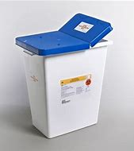
Blue puncture proof leak proof Container

Slide 50
Blue Puncture Proof Leak Proof Container

Slide 51
Community setting (Applicable to all staff)
Individuals without respiratory symptoms should:
Avoid agglomerations and frequency of closed crowded spaces;
Maintain distance of at least 1 meter from any individual with 2019-ncov respiratory symptoms (e.G., Coughing, sneezing);
Perform hand hygiene frequently, using alcohol-based hand rub if hands are not visibly soiled or soap and water when hands are visibly soiled;
If coughing or sneezing, cover nose and mouth with flexed elbow or paper tissue, dispose-off tissue immediately after use and perform hand hygiene;

Slide 52
Community setting (Applicable to all staff)
Refrain from touching mouth and nose;
A medical mask is not required, as no evidence is available on its usefulness to protect non-sick persons.
However, masks might be worn according to local cultural habits.

Slide 53
Community setting (Applicable to all staff)
Individuals with respiratory symptoms should:
Wear a medical mask and seek medical care if experiencing fever, cough and difficulty breathing, as soon as possible or in accordance with to local protocols;
Follow the below advice regarding appropriate mask management.

Slide 54
Health care workers should:
Wear a medical mask when entering a room where patients suspected or confirmed of being infected with 2019-ncov are admitted and in any situation of care provided to a suspected or confirmed case;
Use a particulate respirator at least as protective as a US national institute for occupational safety and health (niosh)-certified N95, European union (EU) standard FFP2, or equivalent, when performing aerosol-generating procedures such as:
Tracheal intubation
Non-invasive ventilation
Tracheotomy
Cardiopulmonary resuscitation
Manual ventilation before intubation and
Bronchoscopy

Slide 55
Source of the above information
https://www.mohfw.gov.in/pdf/National%20Guidelines%20for%20IPC%20in%20HCF%20-%20final%281%29.pdf

Slide 56
Thank You

